Slide 1
DATA MODEL
Database Systems
Yogiek Indra Kurniawan
yogiek@ums.ac.id
Universitas Muhammadiyah Surakarta

Slide 2
Data Model
Set of conceptual tools to describe data, data relationships, semantics (meaning) of data and data limits

Slide 3
Data Model Group’s
Based on Object
entity relationship model
object oriented model
semantic data model
functional data model
Based on Record
Relational model
Hierarchical model
Network Model

Slide 4
E-R Model Main Components
Entity
Relation
Attribute / property

Slide 5

Entity
Individuals that representing something real (existence) and can be distinguished from something else
Entity : person
Sumijan
Sukijan
Sudirman
Entity : person
Students

Slide 6
Relation
Relationship from one or more entity
Students
have
Organization

Slide 7
Attribute
Characteristic from entity or relationship that provides detail explanation from that entity/relationship
major
gpa
name
#nim
Students

Slide 8
Cardinality
Shows maximum number of entity that can relate to entity in the another entity sets.

Slide 9
Cardinality
One to one
One to many
Many to One
Many to Many

Slide 10
One to One
Relationship one entity with one entity (any entity on the set X associated with at most with one entity in the entity set Y and vice versa every entity in the entity set Y associated with at most with one entity in the entity set X)

Slide 11
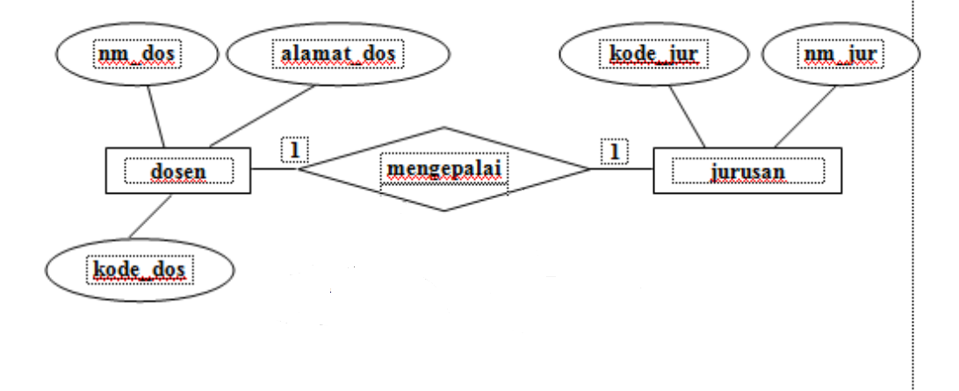
One to One

Slide 12
One to Many
Relationship one entity with many entity (every entity in the entity set X associated with many entities in the entity set Y, but not vice versa, where each entity in the entity set Y associated with at most with one entity in the entity set X)

Slide 13
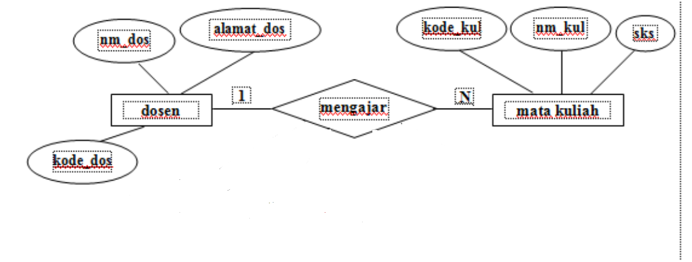
One to Many

Slide 14
Many to One
Many entity relationship with one entity (every entity in the entity set X associated with at most with one entity in the entity set Y, but not vice versa where each entity on a set Y associated with many entities in the entity set X)

Slide 15
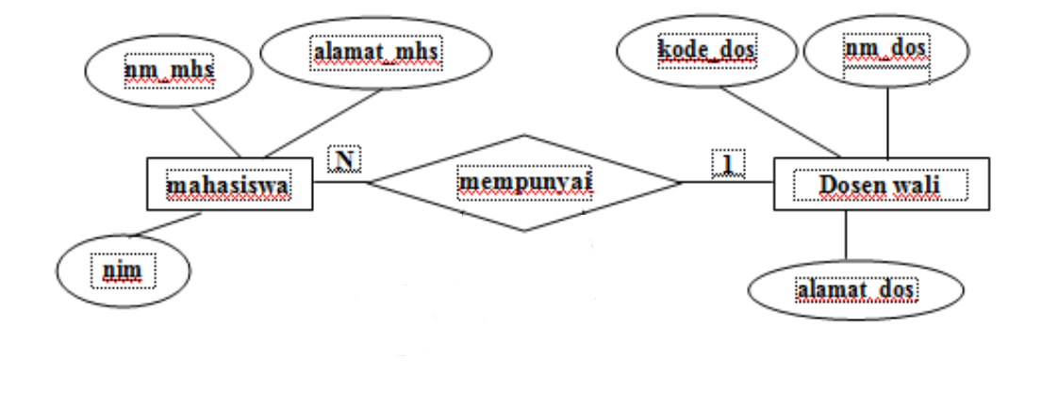
Many to One

Slide 16
Many to Many
Many entity relationship with many entity (every entity in the entity set X can be associated with many entities in the entity set Y and vice versa every entity in the entity set Y can be associated with many entities in the entity set X)

Slide 17
Many to Many

Slide 18
Keys
The use of keys is a way to distinguish an entity in the entity set with another entity.
Key(s) is one or a combination of several attributes that distinguish all row in a relation uniquely.
3 keys :
Super Key
Candidate Key
Primary Key

Slide 19
3 Keys
Super Key
One or more attributes (set of attributes) that can distinguish every rows of data in a relationship uniquely.
Candidate Key
Minimal set of attributes that distinguishes each row of data in a relationship uniquely.
Primary Key
one of the candidate key that be elected
The reasons for selecting primary key
More often be referenced
more concise
Better guarantee key uniqueness

Slide 20
Contoh
Super Key
ex
Nim, nama, alamat, kota
Nim, nama, alamat
Nim, nama
Nim
Candidate Key
ex
Nim
Primary Key
ex
Nim

Slide 21
E-R Diagram
Identify and define the entire set of entities that will be involved
Determine the key attributes of each entity set
Identify and define the entire set of relations between the entity sets who will be with foreign-key
Determining the degree / cardinality relation to each set of relations
Completing the set of entities and a set of relations with descriptive attributes (non-key)

Slide 22
Data Dictionary
Contains a list of attributes that flanked less curly ( { / } ). Which serves as a key attribute is also distinguished by attributes that are not key with underlined.

Slide 23
Mahasiswa = {nim, nama_mhs, alamat, tgl_lhr}
matakuliah= {kode_kul, nama, sks}
dosen= {kode_dos, nama_dos, alamat_dos}
mempelajari= {nim, kode_kul}

Slide 24
Entity Set
Strong Entity Sets
Weak Entity Sets

Slide 25
Weak Entity Sets
Contains entities whose occurrence depends on the existence of a relation to another entity (strong entity)

Slide 26
Weak Entity Sets

Slide 27
Specialization
The separation of the entities can be done, if starting from a set of entities and then grouping which gave birth to a new entity set (top down process)

Slide 28
Generalization
Student entity can actually be divided into two groups, namely S1 and D3 Students. But these groupings are not reinforced by differences in attributes. Because it does not specifically attribute the differences of the two groups, the groups that entity will be incorporated into a set of entities with the same attributes.

Slide 29
Aggregation
A relationship is formed not only from entities but also contain elements from other relations.

Slide 30
THANK YOU

